Slide 1
Fourier Transforms
Da Zhou (周 达)
zhouda@xmu.edu.cn

Slide 2

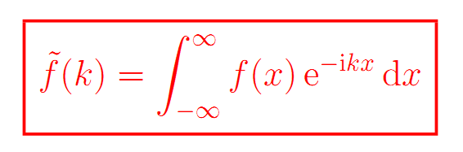
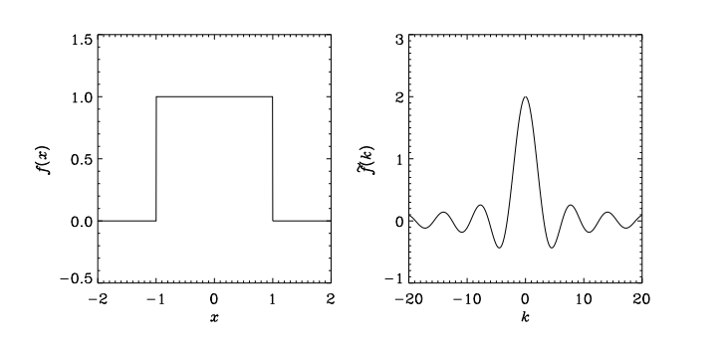
Forward Fourier transform

Slide 3

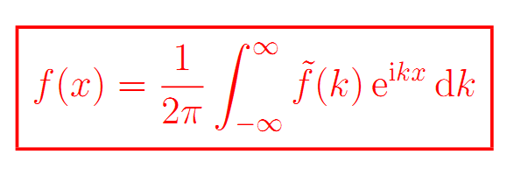
Inverse Fourier transform

Slide 4
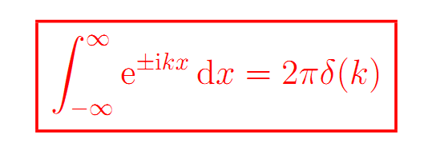
Fourier transform of a unit constant

Slide 5

Fourier transform of $e^{iw_{0}x}$

Slide 6
Fourier transform of $e^{iw_{0}x}$

Slide 7

Fourier transform of $sinw_{0}x$

Slide 8
Fourier transform of $sinw_{0}x$

Slide 9
Fourier transform of period functions

Slide 10
Fourier transform of period functions

Slide 11
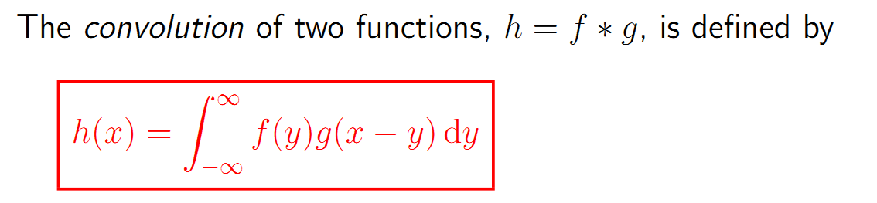
The convolution theorem

Slide 12
The convolution theorem

Slide 13
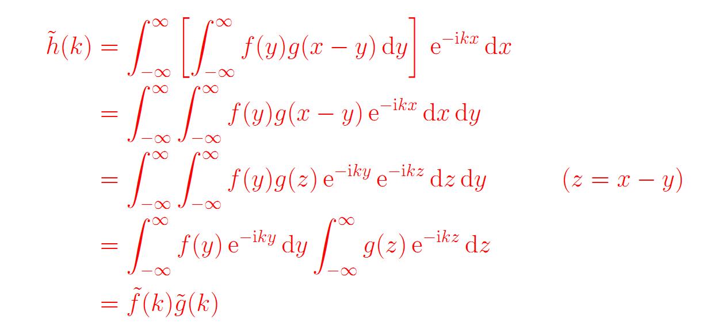
The convolution theorem

Slide 14
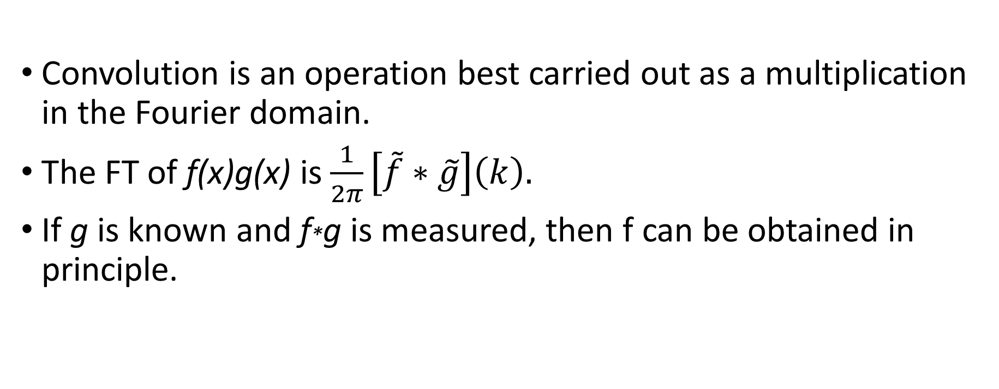
The convolution theorem
Convolution is an operation best carried out as a multiplication in the Fourier domain.
The FT of f(x)g(x) is $\frac{1}{2π}\left[\tilde{f}∗\tilde{g}\right]\left(k\right).$
If g is known and f*g is measured, then f can be obtained in principle.

Slide 15
Correlation (互相关函数)

Slide 16
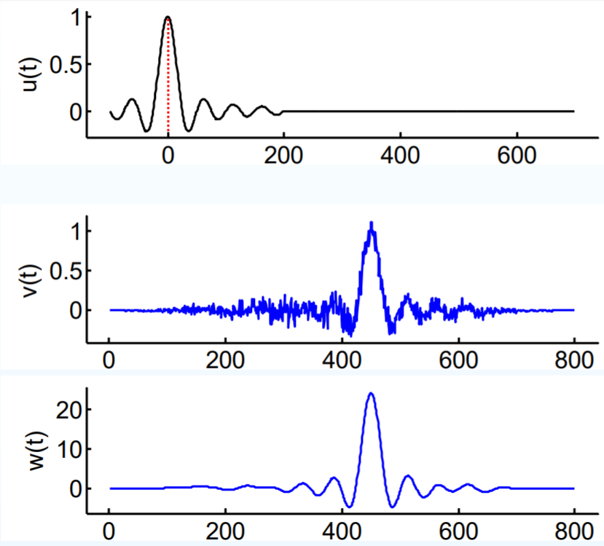
Correlation (互相关函数)

Slide 17
Wiener–Khinchin (WK) theorem

Slide 18
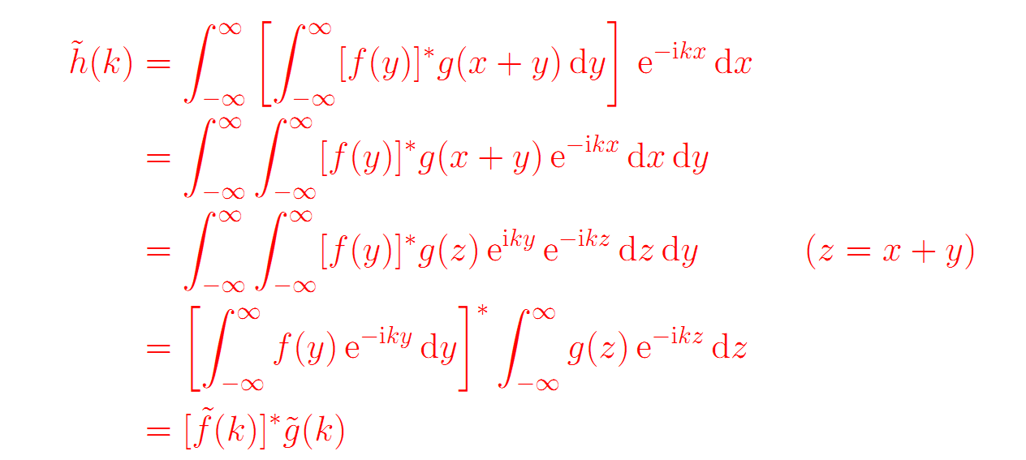
Wiener–Khinchin (WK) theorem

Slide 19
Parseval’s theorem (Fourier series)

Slide 20

Parseval’s theorem (complex form of Fourier series)

Slide 21
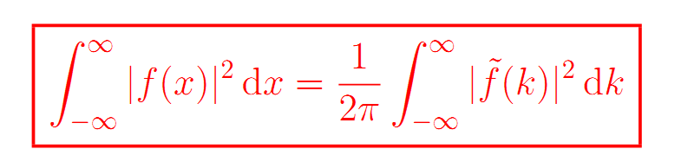
Parseval’s theorem (Fourier transform)

Slide 22
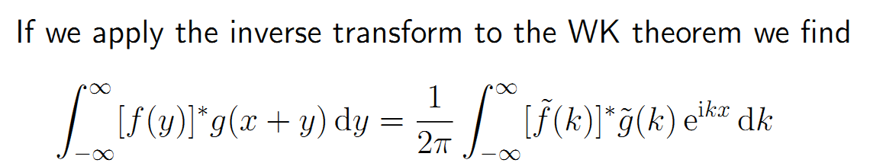

Slide 23
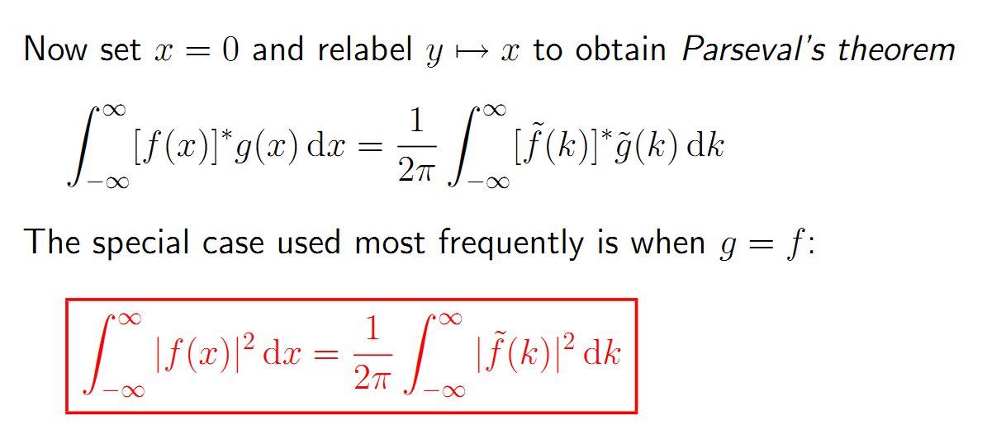

Slide 24

Essential of Parseval’s theorem
More generally, Parseval‘s identity holds in any inner-product space:

Slide 25
Essential of Parseval’s theorem
More generally, Parseval‘s identity holds in any inner-product space:
The Parseval’s theorem is a generalization of the Pythagorean theorem!!

Slide 26
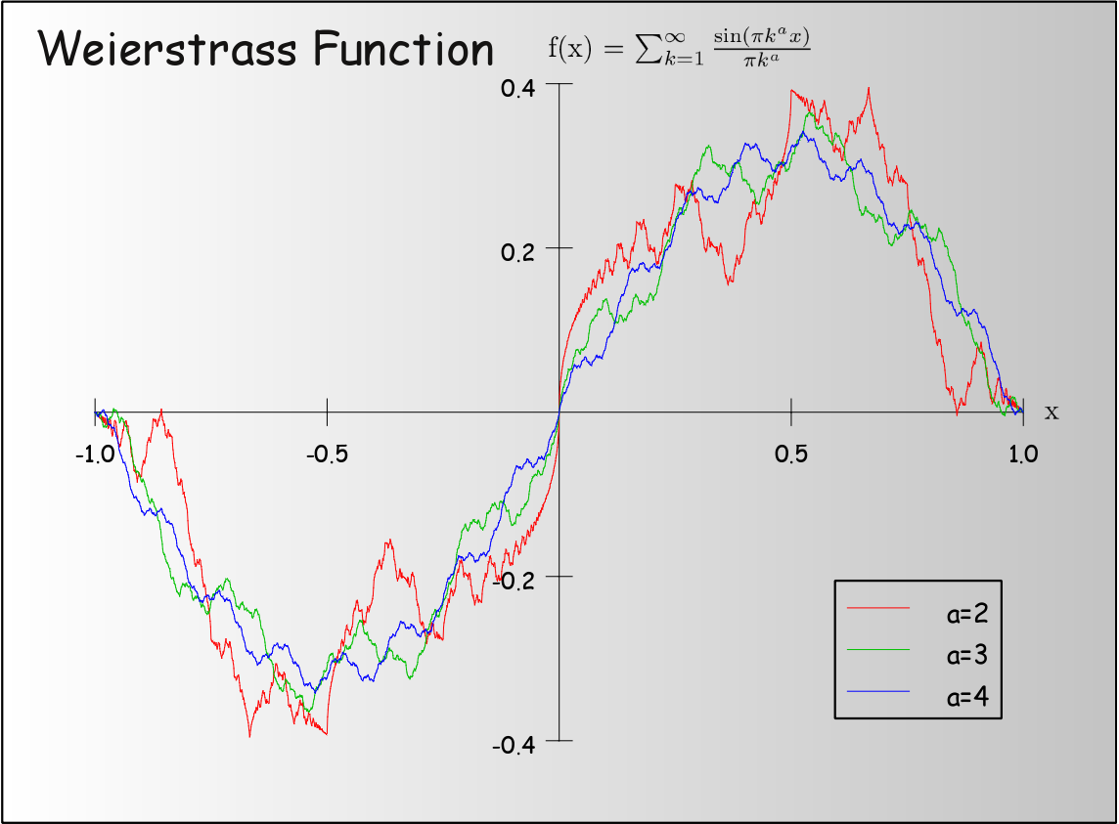
Summary of infinite series section
Infinite series greatly enrich the concept of function

Slide 27
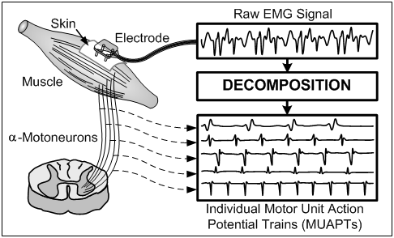
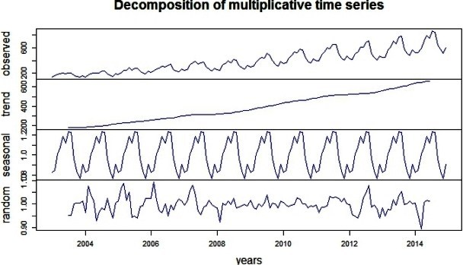
Summary of infinite series section
“Breaking up the whole into parts” (化整为零)
“Feature representation”（特征表示）

Slide 28
Summary of infinite series section
Infinite series
Sum function
Elementary function
Expansion
Convergence test

Slide 29
Summary of infinite series section
Fourier series
Time
domain
Fourier Transform
Frequency domain
Inverse FT

